Slide 1


Corporate Overview
DIGITAL TRANSFORMATION. HUMAN INNOVATION.

Slide 2

We offer human innovation through digital transformation services, and digital and mainstream technology staffing.

Slide 3

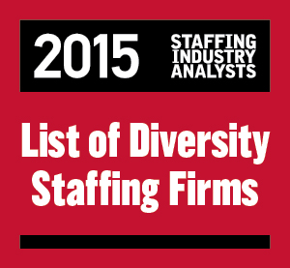





Key Highlights
Pittsburgh-headquartered
Mastech Digital revenues @ $147.9 million
Minority-owned (Certified with NMSDC)
NYSE-listed (MHH)
Data Management & Analytics consulting
Technology-based recruiting delivery
Hybrid Delivery Model (North America and India)
Faster turnaround time
Successful engagements with leading clients across industries
Financial Services
Insurance
Healthcare
Manufacturing
Retail
Energy
Telecom
Aviation
Awards

Slide 4





Offerings
Digital Transformation Services
Data Management & Analytics | Cloud CRM | Enterprise Analytics | Digital Learning Services
Digital Staffing
Social | Mobility | Analytics | Cloud | Automation | IoT | UX/UI
Mainstream Technology Staffing
Mainframes | Databases | Middleware | Enterprise Systems | SoA and Web Services | Data Warehousing | Verification and Validation | IT Administration | IT Helpdesk and Support Business Analysis | Project Management| |
Notes:
Data & Analytics Services
Master Data Management | Enterprise Data Integration | Big Data

Slide 5
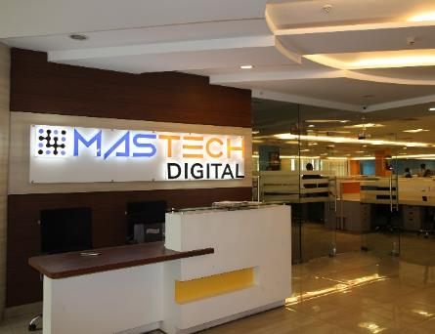




Engagement Models
Consulting & Project-based Delivery
Master Data Management | Enterprise Data Integration | Big Data Analytics
Contract Staffing (on premise)
Contract | Contract-to-Hire | Permanent Staffing
Offshore Staffing Model (OSM)
Requirements in the US | Associates in India | Project Management from India by Mastech Digital (optional)
Key Advantages of OSM
Faster turnaround time in submitting profiles of potential resources for your requirement
Higher efficiency; easy and faster onboarding
Resource and time overlap ensures round-the-clock progress on your projects.
Project-related work during India day. Review and communication during US day.
Optional project management service from India ensures the staffed resources are even more efficient, offshore.

Slide 6

The Mastech Digital Way
Our internal efficiencies and differentiators are the result of successes, learnings, and our talent capital.
Global Delivery Model for Staffing and Digital Transformation Services
Proven track record of being able to source the native as well as rare skill sets and talent combinations
SMART Implementation Methodology – a common-sense, multi-phased approach based on parts of the Rational Unified Process (RUP) and Agile development methodologies
Metrics and insights to manage your Master Data, powered by Veriscope
Equal Opportunity Employer; 1,500+ associates and growing
Egalitarian work culture; digital technologies company with a heart

Slide 7

Toronto
Boston
Fremont
Pittsburgh
Chicago
Dallas
Austin
Orlando
Tampa
NOIDA
Chennai

Slide 8

Thank You
For queries please contact:
+1.800.627.8323
experience@mastechdigital.com

